Slide 1






Study of an intrinsically safe infrastructure for training and research on nuclear technologies
M. Ripani
INFN, Sezione di Genova, Via Dodecaneso 33, Genova 16146, Italy

Slide 2
S.Frambati, L.Mansani, M.Bruzzone, M.Reale
Ansaldo Nucleare SpA, C.so F.M. Perrone 25,Genoa 16152, Italy
S. Monti ◊
ENEA, Via Martiri di Monte Sole, 4, Bologna 40129, Italy
M. Ciotti
ENEA, Via Enrico Fermi, 45, Frascati (Rome) 00044, Italy
M. Barbagallo, N. Colonna
INFN, Sezione di Bari, Via E. Orabona n. 4, Bari 70125, Italy
Celentano, M. Osipenko, G. Ricco, M. Ripani, P. Saracco, C.M. Viberti
INFN, Sezione di Genova, Via Dodecaneso 33, Genova 16146, Italy
O. Frasciello
INFN, Laboratori Nazionali di Frascati, Via Enrico Fermi, 40, Frascati (Rome) 00044, Italy
P. Boccaccio, J. Esposito, A. Lombardi, M. Maggiore, L. Piazza, G. Prete
INFN Laboratori Nazionali di Legnaro, Viale dell'Università 2, Legnaro (Padova) 35020, Italy
R. Alba, L. Calabretta, G. Cosentino, A. Del Zoppo, A. Di Pietro, P. Figuera, P. Finocchiaro, C. Maiolino, D. Santonocito, M. Schillaci
INFN Laboratori Nazionali del Sud, via S.Sofia 62, Catania 95125, Italy
A. Kostyukov
Lomonosov Moscow State University, GSP-1, Leninskie Gory, Moscow 119991, Russian Federation
A. Cammi, S.Bortot, S.Lorenzi, M. Ricotti
Politecnico di Milano, Piazza L. da Vinci, 32, Milan 20133, Italy
S.Dulla, P.Ravetto
Politecnico di Torino, Corso Duca degli Abruzzi, 24, Turin 10129, Italy
G. Lomonaco, A. Rebora
Università di Genova, Via all'Opera Pia, 15, Genoa 16145, Italy
D. Chiesa, M. Clemenza, E. Previtali, M. Sisti
Università di Milano Bicocca, Piazza dell'Ateneo Nuovo, 1, Milan 20126, Italy
D. Alloni, A. Borio di Tigliole ◊, M. Cagnazzo, R. Cremonesi, G. Magrotti, S. Manera, F. Panza, M. Prata, A. Salvini
Università di Pavia (LENA), via Aselli 41, Pavia 27100, Italy
◊ Currently at IAEA, Wagramer Straße 5, Vienna 1220, Austria

Slide 3
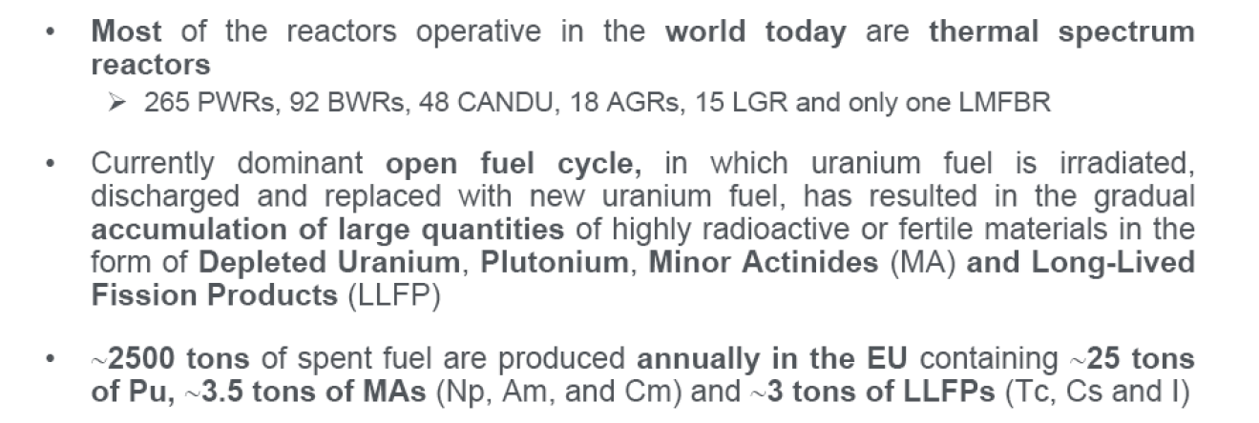
Nuclear waste management

Slide 4
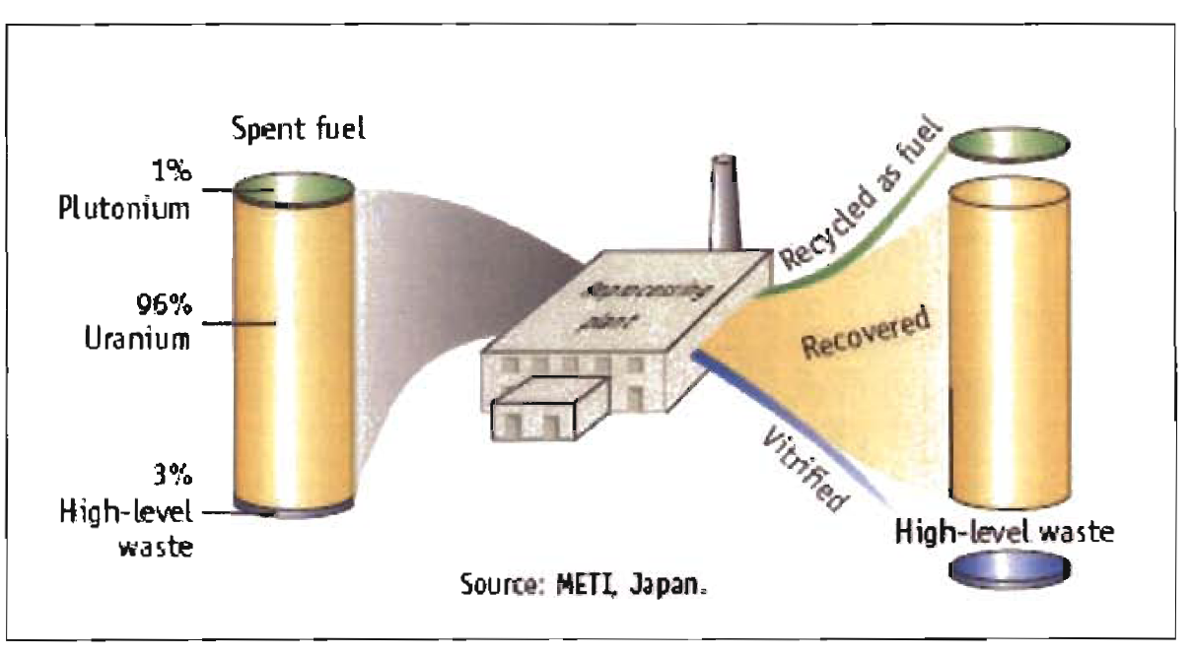
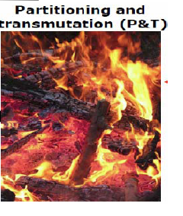
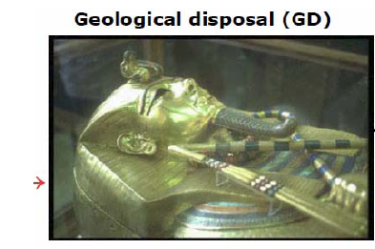
The reprocessing cycle
In Europe and Japan for spent fuel reprocessing is adopted:

Slide 5
Nuclear waste transmutation
Transmutation (or nuclear incineration) of radioactive waste
Neutron induced reactions that transform long-lived radioactive isotopes into stable or short-lived isotopes.
Transmutation reactions
Long-Lived Fission Fragments (LLFF)
151Sm, 99Tc, 121I, 79Se …
neutron capture (n,γ)
  Pu and Minor Actinides
  240Pu, 237Np, 241,243Am, 244,245Cm, …
neutron-induced fission (n,f)
neutron capture (n, γ)
n + 99Tc (2.1x105 y) 100Tc (16 s) 100Ru

Slide 6
Apart for 245Cm, minor actinides are characterized by a fission threshold around the MeV.
In order to transmute actinides, need fast neutrons → minimal moderation in intermediate medium → (cooling) medium must be gas, sodium, lead, etc.
➔ Such isotopes can be burnt in fast reactors or in fast Accelerator Driven Systems (ADS) (neutron spectrum from 10 keV to 10 MeV)
Generation IV ADS
Neutron energy
spectrum In fast
Reactors (Gen IV ADS)
Fission probability in
Minor actinides
1 MeV
Delayed neutron fraction from FF, e.g.:
235U = 0.65 %
241Am = 0.113 %
In ADS delayed neutrons emitted by FF are less important for the reactor control: fast ADS can therefore be fueled with almost any Transuranic element and burn them
Fast ADS → good candidates as transmuters of high activity and long lifetime (thousands of years) Generation III reactor waste into much shorter lifetime fragments (few hundred years), to be stored in temporary surface storage. But further R&D is still needed

Slide 7
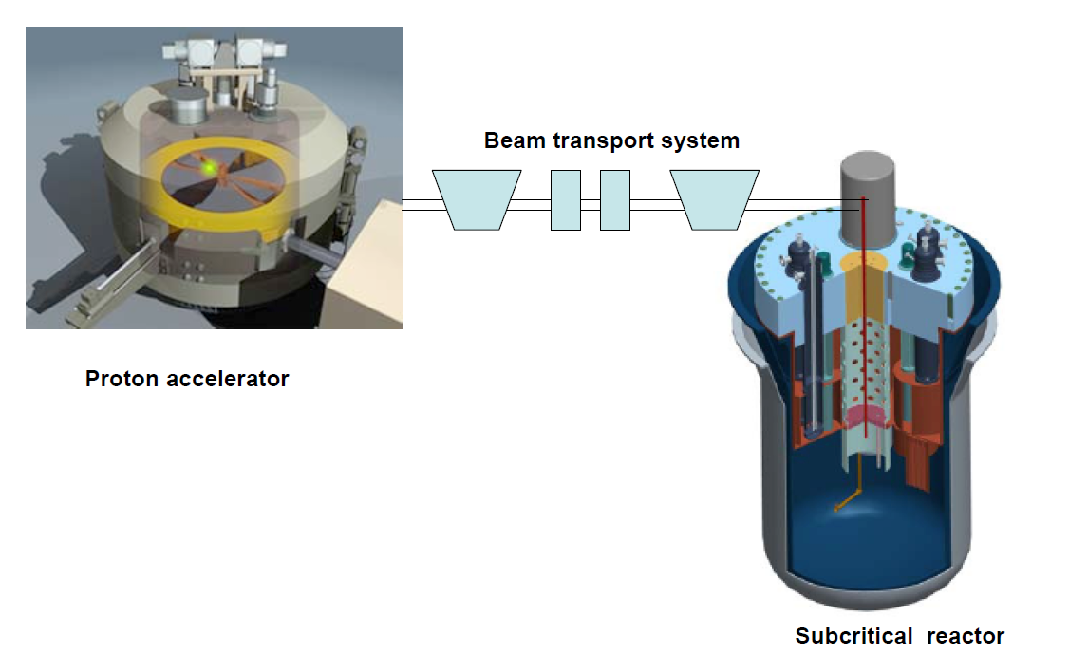
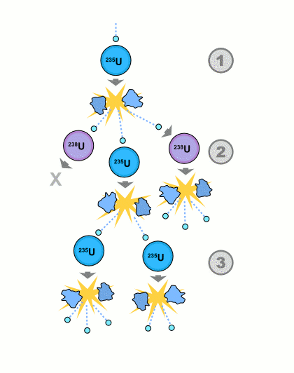
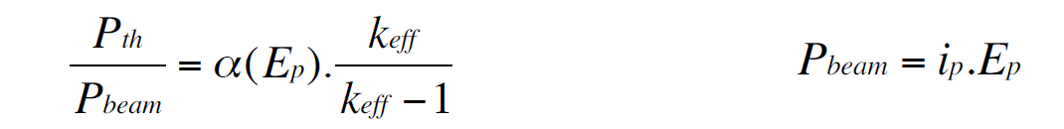
ADS:a three component infrastructure
In ADS, effective multiplication of neutrons is < 1→ need an external neutron source → accelerator+target
The maximum thermal power P_{th} from the subcritical reactor is limited (and controlled !) by the input beam power P_{beam}

Slide 8
Accelerator requirements:
The particle accelerator
High neutron production rate (proton or deuteron beams)
High beam power (high energy E_{p} and/or current i_{p})
Very high stability (for high-power ADS):very few beam trips during long running times
Minimal electric power consumption P_{abs}: i.e. optimal P_{abs} /P_{beam} ratio (from 4 to 25 in existing accelerators)
Most of these requirements are more severe than in conventional research accelerators and require, at least for high power ADS, a special design

Slide 9
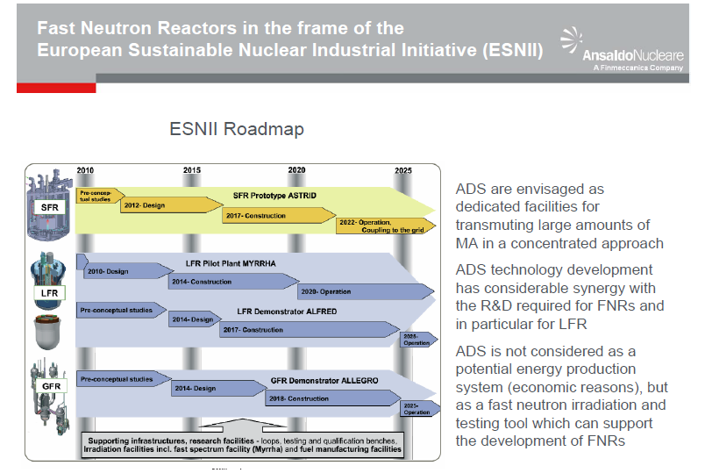

Slide 10

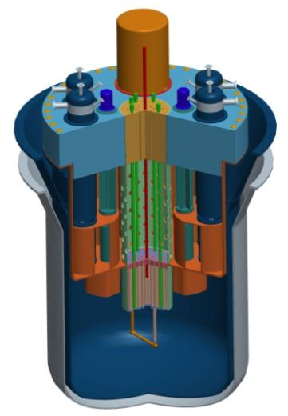
European Lead Fast Reactor (LFR)/ADS Activities
Accelerator
(600 MeV - 4 mA proton)
Reactor
Subcritical mode - 65 to 100 MWth
MYRRHA
project schedule
2010-2014
Front End
Engineering
Design
2015
Tendering &
Procurement
2016-2018
Construction of
components &
civil engineering
2019
On site
assembly
2020-2022
Commissioning
2023
Progressive
start-up
2024-
Full
exploitation
GUINEVERE and MYRRHA
the first two steps of the EU Road Map for the development of LFR technology
GUINEVERE
The Zero-Power facility – solid Lead – critical and sub-critical operation
Nuclear data, nuclear instrumentation, Keff measurements, code validation
Criticality reached in February 2011
Subcritical coupling performed in October 2011
MYRRHA
(Multipurpose hYbrid Research Reactor for High-tech Applications, estimated cost - 960 M€)
European Technology Pilot Plant of LFR
Lead-Bismuth
coolant
See plenary talk on Myrrha by Dr. M. Schyns

Slide 11
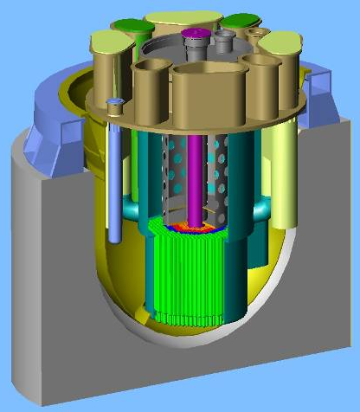
European Lead Fast Reactor (LFR)/ADS Activities
FUTURE GOAL: EFIT (European Facility for Industrial Transmutation)
Pure lead-cooled reactor of several hundreds MW with MA burning capability and electricity generation at reasonable cost
  ⇨ EFIT shall be an effective burner of MA
  ⇨ EFIT will be loaded with U-free fuel containing MA
  ⇨ EFIT will generate electricity at reasonable cost
  ⇨ EFIT will be cooled by pure lead (a cooled gas option is also studied)

Slide 12
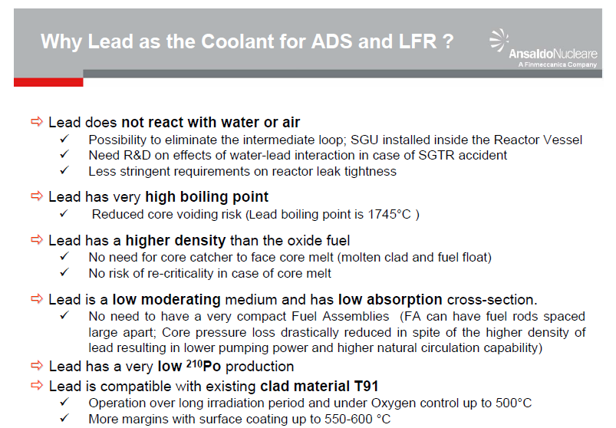
Research in Italy by Ansaldo Nucleare, ENEA, CIRTEN and others
Courtesy of L. Mansani, Ansaldo Nucleare

Slide 13
Requirements for a research and training infrastructure
Few basic requirements:
Safety
Security
Sustainability
Flexibility
High Tech
→ Subcritical ADS system
→ Low power,U235 fueled (negligible Pu and MA)
→ Fast neutrons for transmutations (gen IV ADS)
→ Interchangeable fuels and materials
→ Lead Technology (Italian Leadership with ANN,ENEA,CIRTEN)
determined our proposal:
A fast ADS: a solid lead matrix, fueled with 20% enriched U235 bars, cooled
with a He gas flow for a thermal power of few hundred Kilowatts

Slide 14
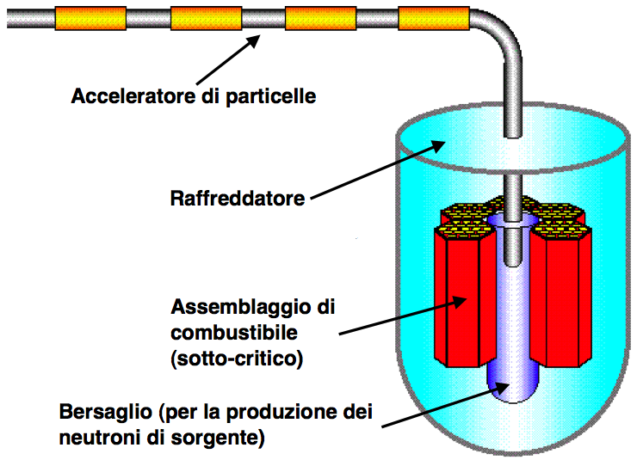
A low power ADS based on enriched U fuel and solid Lead
Motivation
Reference to 70 MeV, 0.5 mA proton cyclotron purchased by INFN for Legnaro Laboratory as a possible driver
Collaboration with Ansaldo Nucleare, leader in technology for fast reactors based on Lead coolant (also, one of the proposed technologies in the EU)
Choice of Pu-free fuel to minimize security issues → UO₂ w/ 20 % 235U
Low thermal power 150-200 kW to limit safety issues but sufficient to study some aspects of dynamics
Temperature < 300 Cº → solid Lead matrix
k_{eff} ∼ 0.95 (limit for storage facil’s)
Relatively low beam energy → Target: Beryllium (weakly bound n)
Broad collaboration between INFN, Ansaldo Nucleare, ENEA, Politecnico di Milano, Politecnico di Torino, LENA-Pavia, University of Genova
Particle accelerator
Cooling medium
Sub-critical
fuel assembly
Target as primary source of neutron production

Slide 15
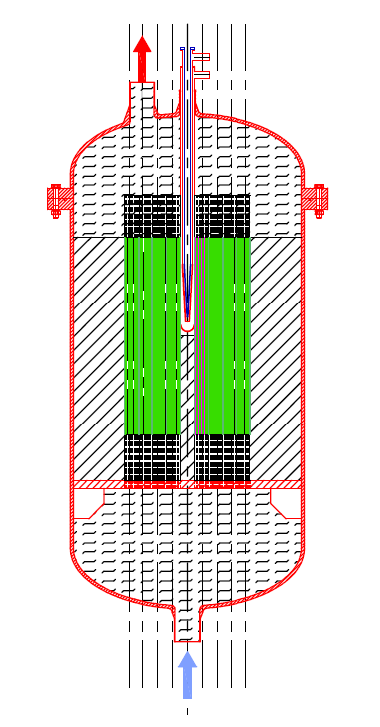
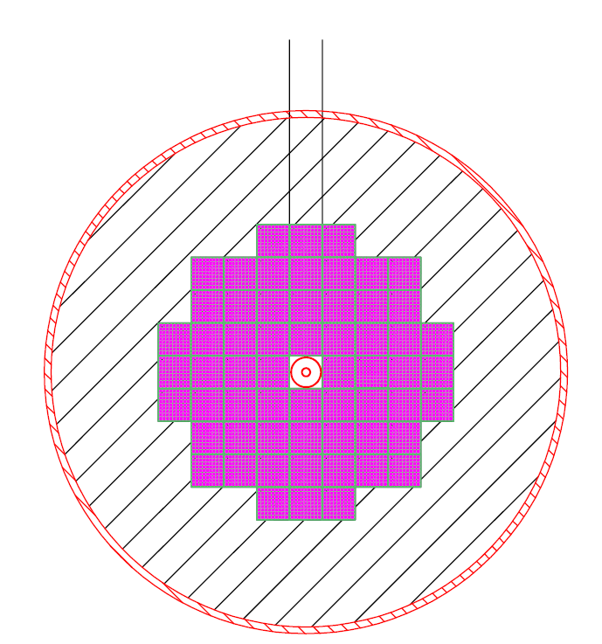
The subcritical apparatus
Proton Beam
Vessel
2 cm thk
(5 ton)
He
outlet
Upper He
Plenum
2400
Target
900
1600
Active fuel
Fast core
Solid Lead matrix (94 t)
Fuel:
UO₂ 20 % (1.8 t)
Proton beam:
p @ 70 MeV
I = 0.75 mA
~ 4.6·1015 p/s
Target: Beryllium
He as coolant
He
inlet
Lower He
Plenum

Slide 16
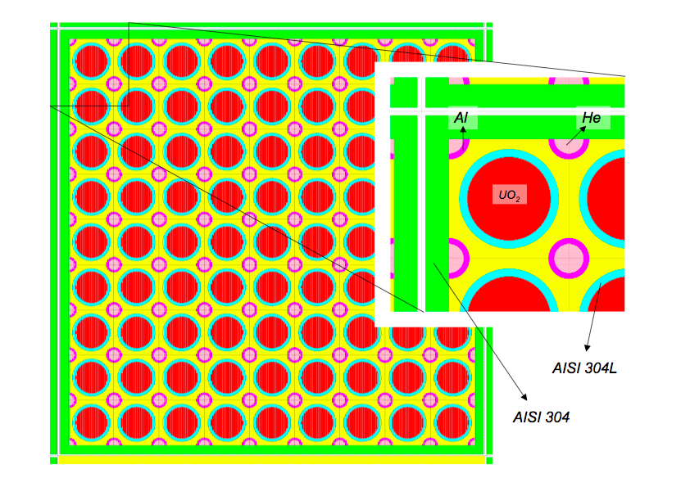
Fuel assembly
Fuel Assembly
y
z=0
x
(h_{active} = 90 cm)
h_{FA}= 130 cm
L_{FA} ≅ 9.7 cm
∼30 kg UO₂-enr./FA
∼45 kg Pb/FA

Slide 17
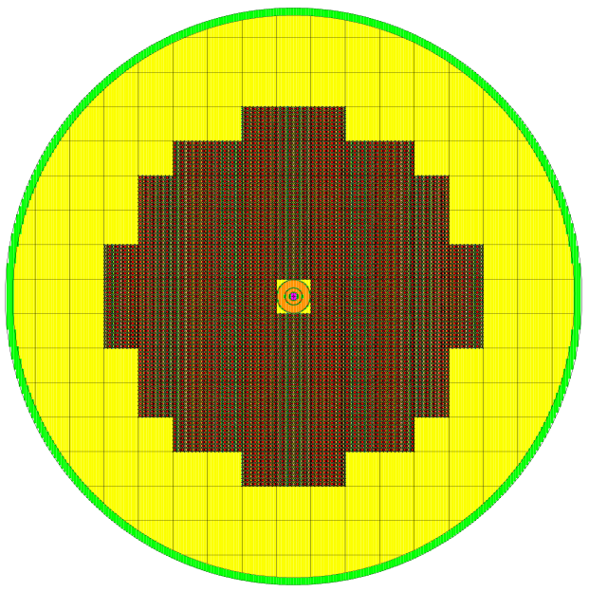
The subcritical core
Requirement:
  k_{eff} ∼ 0.95
y
z=0
x
r_{tot}
How many FAs?
What reflector size and r_{tot}?
vessel
reflector
FAs
Beamline & target

Slide 18
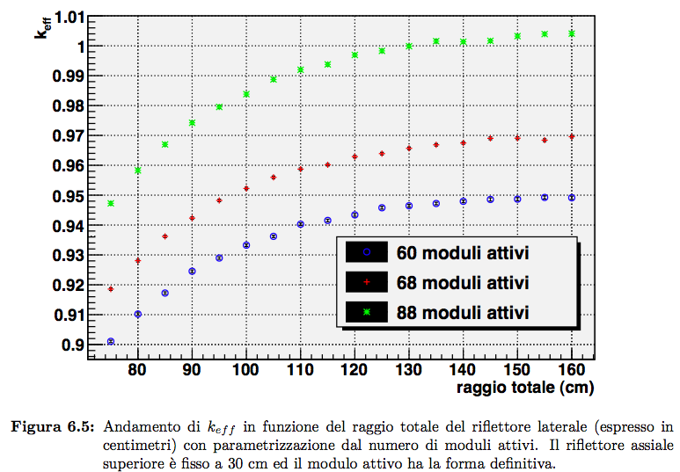
Core design (Full load)
MCNPX 2.6.0, kcode, ENDF/B.-VII
Fuel assemblies
Fuel assemblies
Fuel assemblies
Total radius (cm)
Upper reflector height: 30 cm

Slide 19

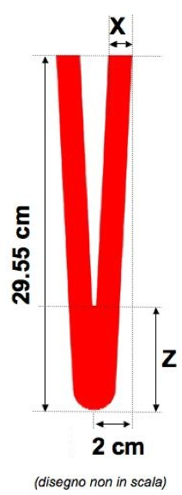
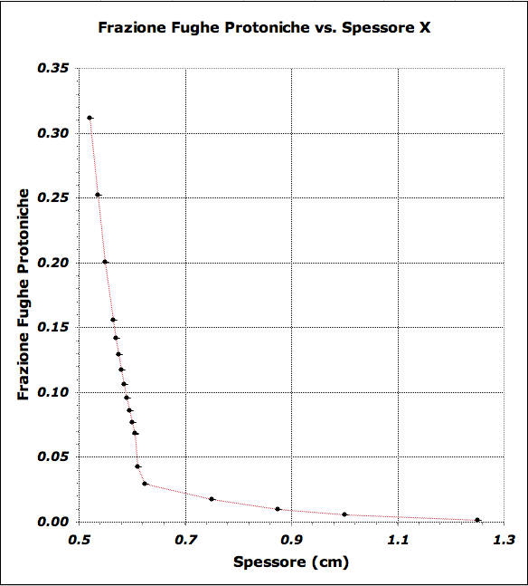
Target shape and size
Beryllium cone, inspired by previous project TRADE
Fraction of escaping protons vs thickness X
(Z_{(X)}=20·X-9.5)
thickness X (cm)
Proposed design
thickness X
thickness Z

Slide 20
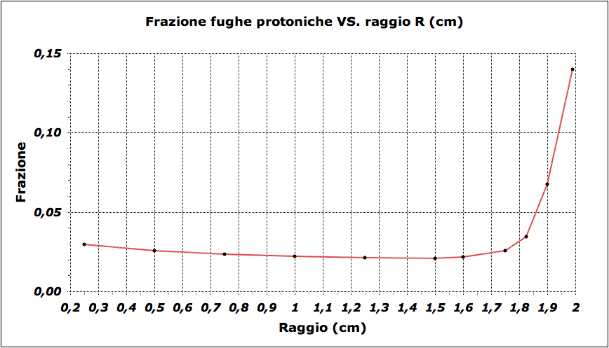
Beam spot
∼ 0.6 cm
Fraction of escaping protons vs radius R
r
3 cm
Radius (cm)
(Z_{(X)}=20·X-9.5)
Dimensione proposta
R = 1.5 cm
Proposed Radius

Slide 21
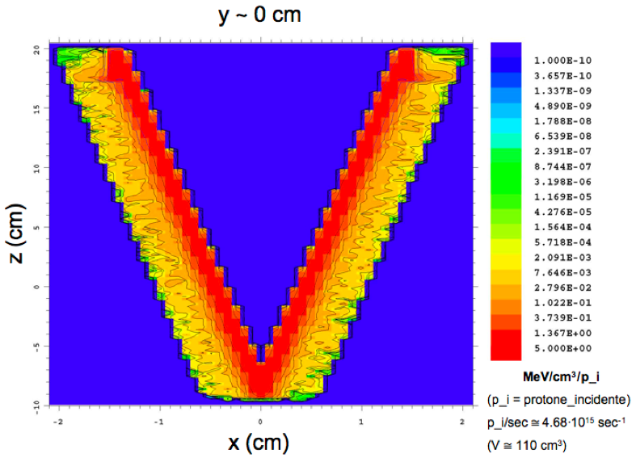

Target heat load and source intensity
Beam current: 0.75 mA
15
10
Important to design the target cooling system
5
0
-5
1 MeV/cm3/p_i = 0.75 kWatt/cm3
20
-10
-1
0
1
2
-2
Total neutron yield:
Neutrons/sec

Slide 22
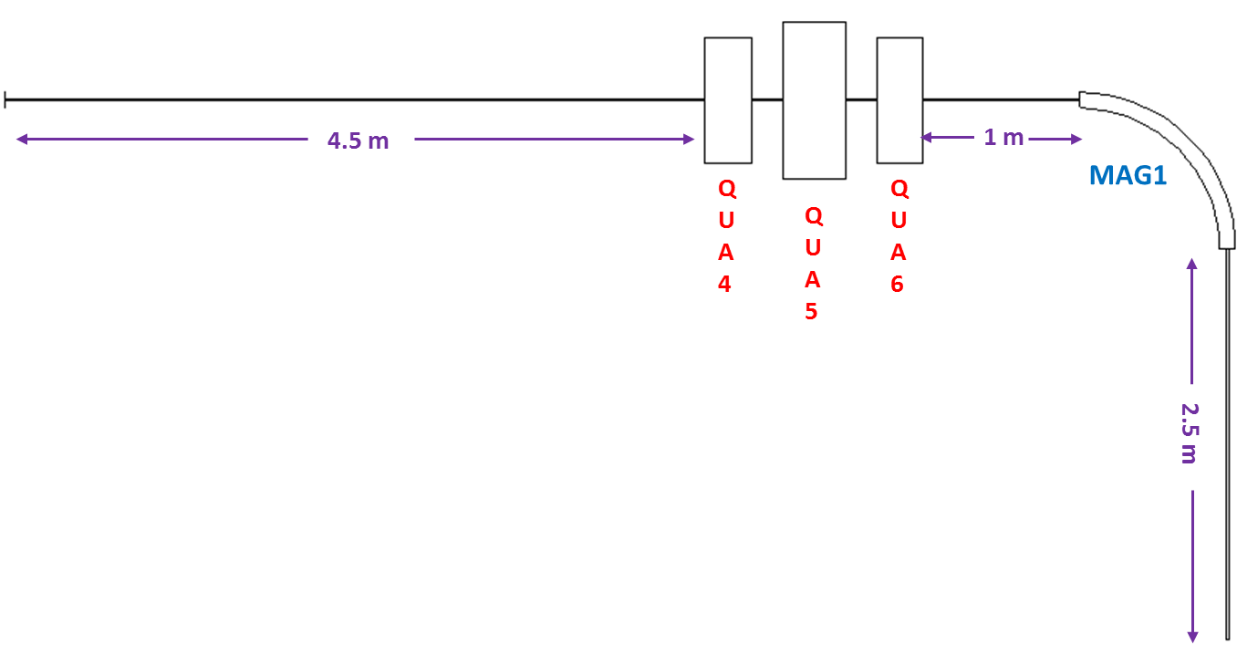
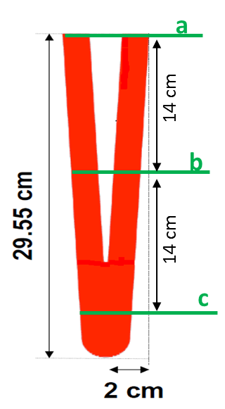
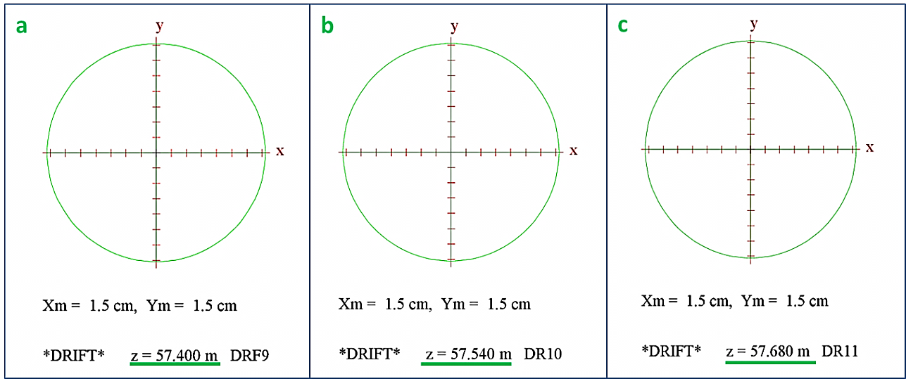
Beam Transport
Beam spot size at the target
The beam profile (in absence of the target) remains constant along the target length → parallel beam

Slide 23
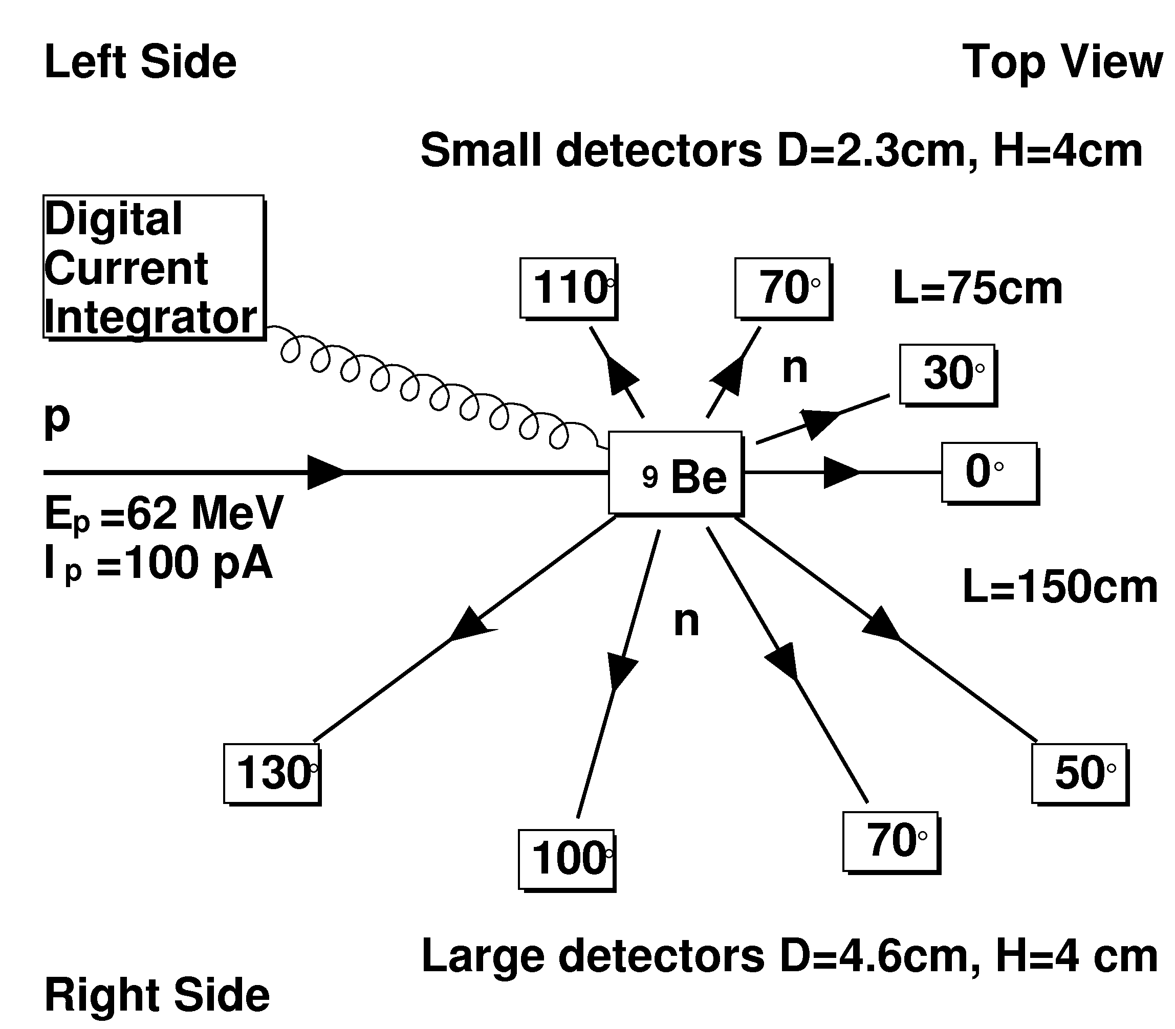
Measurement of differential neutron yield from thick 9Be target (experiment performed at INFN Laboratori Nazionali del Sud)
Beam - E_{p}=62 MeV, I_{p}∼30 pA, 1/5 bunch suppression,
Target – pure 9Be cylinder 3cm×3.5cm ,
Detector – liquid scintillator →PSD,
Method – Time-Of-Flight, reference time is given by RF,
Normalization – charge deposited on the target
Beam structure
125 ns
∼1 ns
- observable
Experimental setup:
8 detectors measured simultaneously
Two dynamical ranges: T_{n}=0.5-2 MeV (left side, 4 small detectors at 75 cm) and T_{n}=2-60 MeV (right side, 4 large detectors at 150 cm),
Charge deposited on the target collected by Digital Current Integrator

Slide 24
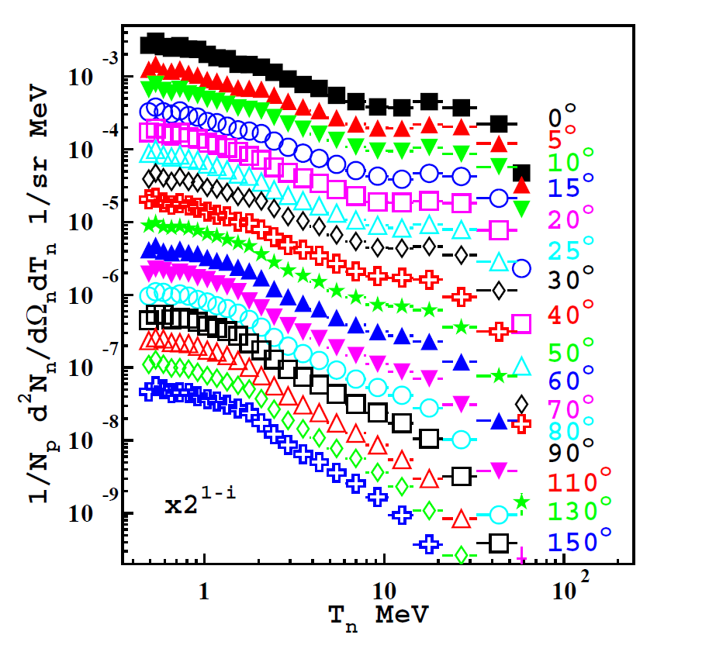
Results on the yield as a function of energy and angle
Nucl. Instrum. Meth. A723 (2013) 8-18
Total neutron yield N_{n}/N_{p} = 0.0987±0.0003 stat.±0.0053 sys. n/p

Slide 25
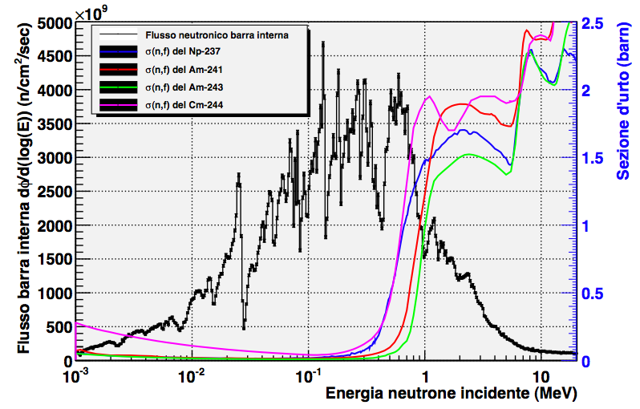
Neutron flux for innermost fuel rod
Integral flux for innermost fuel rod: φ_{tot} ∼6·1012 n/cm2/sec
Fission cross section (barn)
ENDF/B.-VII
Neutron kinetic energy (MeV)

Slide 26
Integral flux for innnermost fuel rod: φ_{tot} ∼6·1012 n/cm2/sec
“Slow” flux:
φ_{<0.5 MeV} ≅ 4.4·1012 n/cm2/sec ⇒ φ_{<0.5 MeV} / φ_{tot} = (69.8±0.5)%
“Fast” flux:
φ_{>0.5 MeV} ≅ 1.9·1012 n/cm2/sec ⇒ φ_{>0.5 MeV} / φ_{tot} = (30.2±0.4)%
ENDF/B.-VII

Slide 27
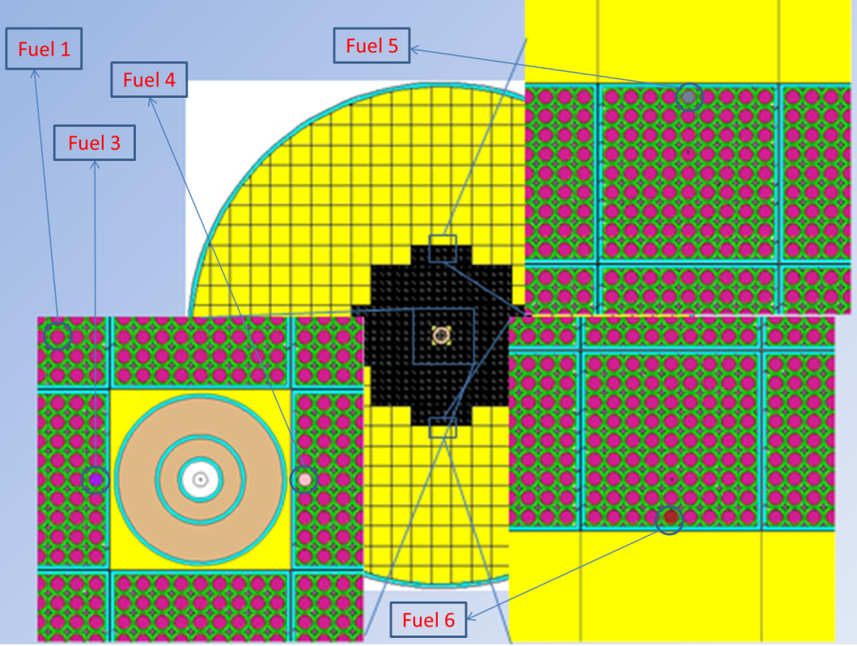
Waste irradiation results
Fuel 3: Full Actinides inner CerCer rod
Fuel 5: Full Actinides outer CerCer rod
Masses [g] for various actinides
(at different times) for fuels 3 and 5
 | Fresh Fuels 3 & 5 | Fuel 3 |  | Fuel 5
 |  | (1y after irradiation) | (10y after irradiation) | (1y after irradiation) | (10y after irradiation)
Np²³⁷ | - | 6.79471e+1 | 7.01532e+1 | 6.79471e+1 | 7.01532e+1
Np²³⁹ | - | 8.86555e-6 | 8.85805e-6 | 8.86555e-6 | 8.85805e-6
Pu²³⁸ | - | 4.73037e-2 | 4.68773e-2 | 3.57616e-2 | 3.53688e-2
Pu²³⁹ | - | 2.16127e-3 | 5.53281e-3 | 2.15127e-3 | 5.52281e-3
Pu²⁴⁰ | - | 5.83828e-2 | 2.47827e-1 | 5.83828e-2 | 2.47827e-1
Pu²⁴¹ | - | 2.29209e-5 | 8.86302e-5 | 2.34927e-5 | 8.90010e-5
Pu²⁴² | - | 6.90999e-3 | 6.90988e-3 | 5.13000e-3 | 5.12991e-3
Am²⁴¹ | 1.57e+2 | 1.56749e+2 | 1.54505e+2 | 1.56749e+2 | 1.54505e+2
Am²⁴³ | 1.03e+1 | 1.02990e+1 | 1.02903e+1 | 1.02990e+1 | 1.02903e+1
Cm²⁴² | - | 3.06488e-3 | 2.58117e-9 | 2.24053e-3 | 1.88693e-9
Cm²⁴³ | 1.88e-2 | 1.77716e-2 | 1.43425e-2 | 1.77716e-2 | 1.43425e-2
Cm²⁴⁴ | 7.18e-1 | 6.61189e-1 | 4.68427e-1 | 6.61189e-1 | 4.68427e-1
Cm²⁴⁵ | 1.26e-1 | 1.25989e-1 | 1.25897e-1 | 1.25989e-1 | 1.25897e-1
Cm244 is substantially the only isotope that undergoes a significant reduction during irradiation (around 8%): considering the well-known toughness in reducing that isotope inside critical reactors, the obtained results appear worthy of further future investigations.
Notes:
è un isotopo che ha relativamente basse sezioni di cattura e/o di fissione al di fuori della zona ad alte energie e di quella delle risonanze (epitermica) ma, soprattutto, ha dei canali di formazione (al di fuori delle due zone segnalate) più efficienti di quelli di bruciamento (quello principale è Pu-242+n --> Pu-243 --> Am-243 poi Am-243+n --> Am-244 --> Cm-244). In più decade in maniera relativamente rapida (vita media e tempo di dimezzamento dell'ordine di 30 e 18 anni), cosa che lo rende difficile da manipolare (per essere inserito nel combustibile fresco, è necessario un processo di produzione remotizzato con adeguate schermature e comunque, come sai, il tenore massimo di MA è limitato, almeno ad oggi, da aspetti tecnologici e di scienza dei materiali), ma decade (alfa) in Pu-240 che, come sai, rimane altamente radiotossico per un lunghissimo periodo di tempo; quest'ultimo se creato all'interno di un reattore, è un fertile che viene convertito abbastanza facilmente in Pu-241 (o, al limite, con opportuni spettri, anche direttamente fissionato) ma se prodotto al di fuori è un serio problema per lo stoccaggio delle scorie (si potrebbe attendere almeno una cinquantina di anni il decadimento di buona parte del Cm-244 in Pu-241 prima di riprocessare lo spent fuel, ma questo tempo è, al momento, abbastanza più lungo dei tempi previsti negli attuali cicli del combustibile prima del riprocessamento). Infine, last but not the least, la separazione chimica fra Am e Cm è al momento testata solo su scala di laboratorio (e con efficienze di separazione non entusiasmanti) e quindi, almeno su scala "industriale" sarebbe necessario trattare assieme Am e Cm; questo comporta una notevole complicazione nella scelta dello spettro neutronico ottimale del reattore/bruciatore, in quanto le zone con le più alte sezioni d'urto di trasmutazione per i due elementi (o meglio per gli isotopi principali degli stessi) sono sostanzialmente diverse (almeno negli spettri "ragionevoli" per i reattori a fissione, i.e. piccati dal centinaio di KeV in giù).

Slide 28
Analysis of fast facilities that can meet the need for experimental data
Experiment Objective | MUSE | SAD | YALINA | MEGAPIE | GUINEVERE | MYRRHA | Our Project
Keff monitoring | NO | YES | YES | NO | YES | YES | YES
Kinetics | NO | NO | NO | NO | YES | YES | YES
Dynamics | NO | NO | NO | NO | NO | YES | YES
Power/beam current | NO | YES | YES | NO | YES | YES | YES
Startup/shutdown | NO | YES | YES | NO | YES | YES | YES
Physics and Code validation | YES | YES | NO | NO | YES | YES | YES
Beam line & target | NO | YES | NO | YES | NO | YES | YES
Safety and licensing | NO | YES | NO | YES | YES | YES | YES
Summary table from “Experimental activities on the Coupling of an Accelerator, a spallation Target and a Sub-critical blanket” (ECATS) part of EU program EUROTRANS
(The apparatus described here is added for comparison)
CDR available at http://www.ge.infn.it/~opisso/CDR/cdr.htm, to be published on EPJ Plus
Task within EU project CHANDA: Study of a new infrastructure to perform dedicated new integral experiments, in order to validate the relevant cross section data in an environment where materials, power and temperature evolve towards future systems like Myrrha, extending the possibility within the EU for specific training of young scientists and engineers

Slide 29
THE EUROPEAN ADS ROAD MAP
GUINEVERE (Mol) prototype
Subcritical P=0kw operating
Measures:k_{eff},fluxes,cross sections
INFN et al. prototype
Subcritical P=200 kw_{t} project(CDR)
Gen IV and transmutation Physics
MYRRHA (Mol)
Crit./subcr P=100Mw_{t}approved(TD)
Optimized for radioisotope production
ALFRED demonstrator lead-cooled critical fast reactor
gen IV P=120Mw_{t}
EFIT Industrial fastADS
P= few 100Mw_{t}

Slide 30
Conclusions
ADS can help study many aspects of novel nuclear systems, i.e. Gen IV assemblies, fast neutron dynamics and waste burnup
At the same time, depending on intensity and spectrum of the neutron field, they can offer other opportunities like detector testing, medical applications and material studies
In the framework of a collaboration between INFN and other Italian academic institutions and industrial partners, a low power ADS has been proposed as a facility for training and research, with safety and flexibility as distinctive features. Such a system would be intermediate between the existing zero power one (Guinevère) and future high power facilities like Myrrha
A CDR was produced as is in the process of being published on European Physical Journal. Funding is currently not available in Italy, but the project may be of interest in the European context as one more step towards future high power apparata

Slide 32
Nuclear waste management
In Italy high activity or long lifetime waste from reactors operating in the past is estimated to about 5000/6000 m3, most of which are presently being reprocessed in England and France, but all of which will be sent back in 2025

Slide 33
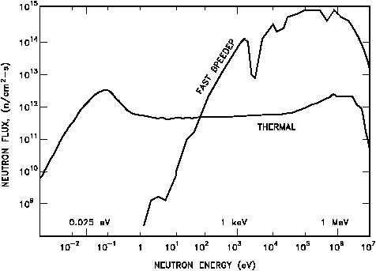
The subcritical reactor
The maximum thermal power P_{th} from the subcritical reactor is limited ( and controlled !) by the input beam power P_{beam}
In real subcritical conditions (k_{eff}<0.99),the reactor time response to power changes ΔP_{beam} is very fast (few microseconds), as delayed neutrons are uninfluent
Subcritical reactors can be thermal (water as coolant) or fast (liquid metal as coolant) with very different neutron spectra

Slide 34
WHAT IS AN ADS FOR?
Electric Power production
Nuclear waste management
Training and research

Slide 35

Electric power production
It has a high safety level, but:
The peak power P_{th} is somewhat limited by the beam power P_{beam}
The Infrastructure and maintenance costs are definitely higher than in a conventional critical reactor
The required advanced technology is not always available
ADS do not seem at the moment the most convenient investment for electric power production

Slide 36
INFN/ANN proposal: the project targets
Training and Education
Physics of fast (gen.IV) reactors
Waste management and transmutation
Production of isotopes for industry and medicine
Study of materials for fission and fusion reactors
Safety and licensing

Slide 37
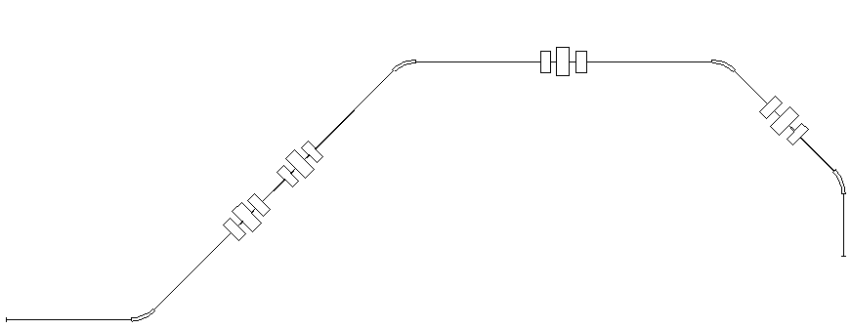
INFN/ANN project:the beam transport system
QUA8
QUA7
QUA9
MAG2
9. 4 m
MAG3
QUA4
QUA5
QUA6
QUA6
QUA5
QUA4
Quadrupole triplet | Magnet length [m] | Radius [m] | Magnetic field [kG]
QUA5 | 0,40 | 0,045 | 3,8
QUA4/QUA6 | 0,30 | 0,035 | -3,0
QUA8 | 0,40 | 0,04 | -3,7
QUA7/QUA9 | 0,30 | 0,03 | 4,5
4.5 m
QUA6
QUA5
QUA4
10,8 m
MAG4
2 m
MAG1
4 m
Bending magnet | Radius [m] | Bending angle [°] | Magnetic Field [kG] | Gap [m] | Pole width [m]
MAG1/MAG2 | 1.0 | -45°/45° | 12.0 | 0,065 | 0,365
MAG3/MAG4 | 1.0 | 45°/45° | 12.0 | 0,065 | 0,365

Slide 38
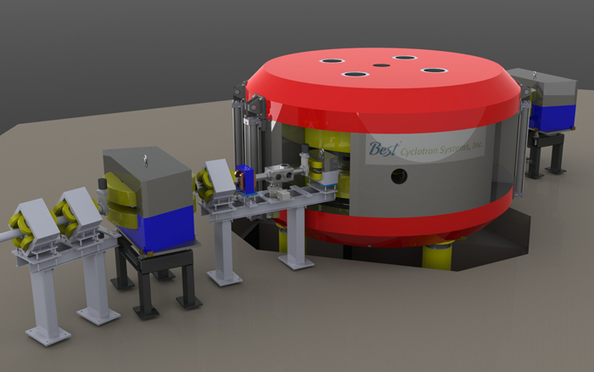
INFN/ANN project: proposed accelerators
SPES cyclotron, mainly devoted to fundamental science (beams of radioactive species)
Legnaro INFN National Lab 2013
Energy 70 MeV Current 0.75 mA
Beam Power 50 KW
Circular machine proton beam Neutron Yield~ 1014neutrons/sec
ADS thermal power=200 KW
International Fusion Materials
Irradiation Facility(IFMIF)
After 2017
Energy=40 MeV Current=125mA
Beam Power=5 MW
Linear accelerator deuteron beam
Neutron yield ~1017neutrons/sec
ADS thermal power=15 MW

Slide 39
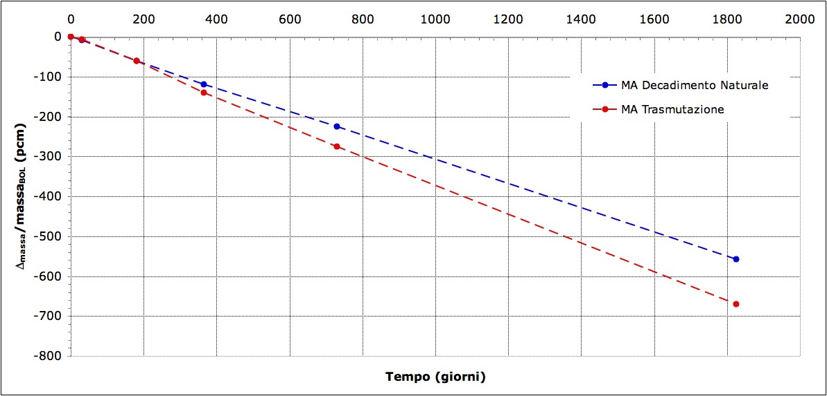
Expected transmutation rates
1 pcm = 1 part per 105 → 0.001 %
MA Natural decay
MA transmutation
∼20 pcm
MA rod in the innermost position
Time (days)
MCB-1c

Slide 40
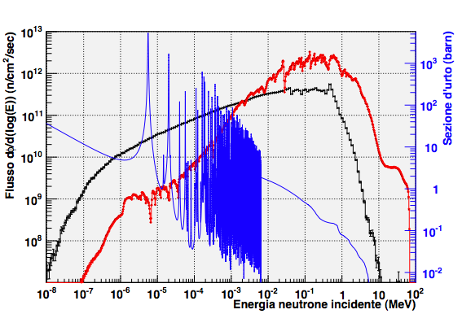
Neutron flux in the reflector
Average integral flux in reflector: φ_{tot} ∼1·1012 n/cm2/sec
( p @ 70 MeV, 0.75 mA )
σ(n, γ) for 99Tc
Average flux active part
Average flux in reflector
ENDF/B.-VII
Neutron kinetic energy (Mev)

Slide 41
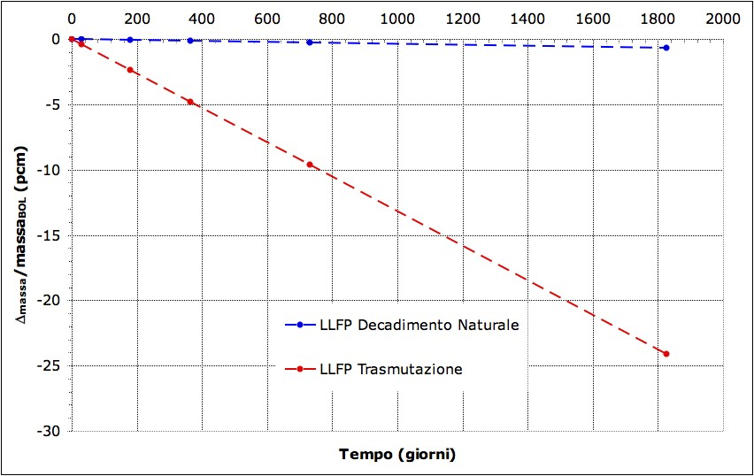
Expected transmutation rates
LLFP rod embedded in the reflector
∼5 pcm
MA Natural decay
MA Transmutation
Time (days)
MCB-1c

